Slide 1

Tree and Graph Traversals
Tree traversals: a data structure-specific operation, and how they generalize to the Graph data type.
Kevin Lin, with thanks to many others.
Notes:
Ask questions anonymously on Piazza. Look for the pinned Lecture Questions thread.
This lecture is much shorter than usual due to the midterm survey.

Slide 2
File System Tree
Sometimes, we want to iterate over a tree.
Formally, this is called a tree traversal. There are several different types of tree traversals.
data
tiles
cities.txt
words.txt
d0_x0_y0.jpg
d0_x1_y0.jpg
d1_x0_y0.jpg

Slide 3
Tree Traversal Orderings
Level-Order Traversal. Visit top-to-bottom, left-to-right (like reading in English): DBFACEG
Depth-First Traversals.
Traverse deep nodes (A, C, E, G) before shallow ones (D, B, F).
Note: “Traversing” a node is different than “visiting” a node.
3 types: Preorder, Inorder, Postorder.
D
B
F
A
C
E
G

Slide 4
Depth-First Traversals
Preorder Traversal. “Visit” a node, then traverse its children.
D
B
A
C
F
E
G
preOrder(BSTNode x) {
if (x == null) return;
print(x.key)
preOrder(x.left)
preOrder(x.right)
}
D
B
F
A
C
E
G

Slide 5
Depth-First Traversals
Inorder Traversal. Traverse left child, “visit”, then traverse right child.
A
B
C
D
E
F
G
inOrder(BSTNode x) {
if (x == null) return;
inOrder(x.left)
print(x.key)
inOrder(x.right)
}
D
B
F
A
C
E
G

Slide 6
Depth-First Traversals
Q
Postorder Traversal. Traverse left, traverse right, then “visit.”
postOrder(BSTNode x) {
if (x == null) return;
postOrder(x.left)
postOrder(x.right)
print(x.key)
}
D
B
F
A
C
E
G
Notes:
Q1: Give the postorder traversal for the graph.

Slide 7
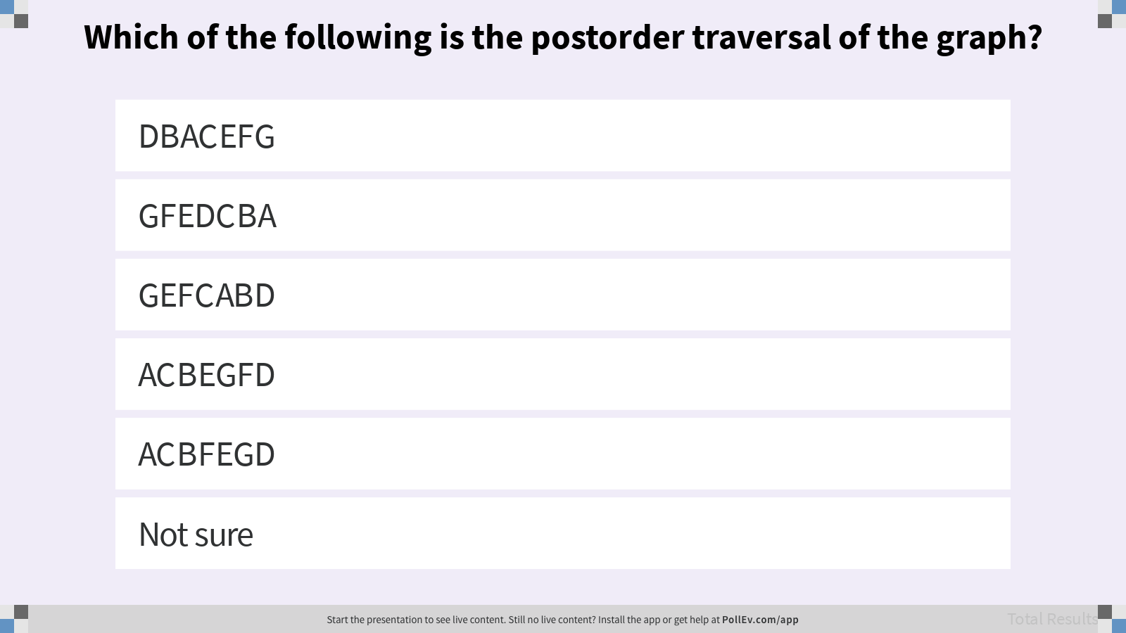
Which of the following is the postorder traversal of the graph?

Slide 8
Depth-First Traversals
A
Postorder Traversal. Traverse left, traverse right, then “visit.”
A C B E G F D
postOrder(BSTNode x) {
if (x == null) return;
postOrder(x.left)
postOrder(x.right)
print(x.key)
}
D
B
F
A
C
E
G

Slide 9
Depth-First Traversals: Visual Trick (for humans)
First, trace a path around the graph from the top going counter-clockwise.
Preorder. “Visit” when passing the left.
Inorder. “Visit” when passing the bottom.
Postorder. “Visit” when passing the right.
A C B E G F D
D
B
F
A
C
E
G

Slide 10
File System Tree
Preorder traversal can print the files in a directory. Postorder can summarize file sizes.
data/
tiles/
d0_x0_y0.jpg
d0_x1_y0.jpg
d1_x0_y0.jpg
...
cities.txt
words.txt
data
tiles
cities.txt
words.txt
3502 K
587 K
d0_x0_y0.jpg
d0_x1_y0.jpg
d1_x0_y0.jpg
13 K
16 K
11 K

Slide 11
Graphs

Slide 12
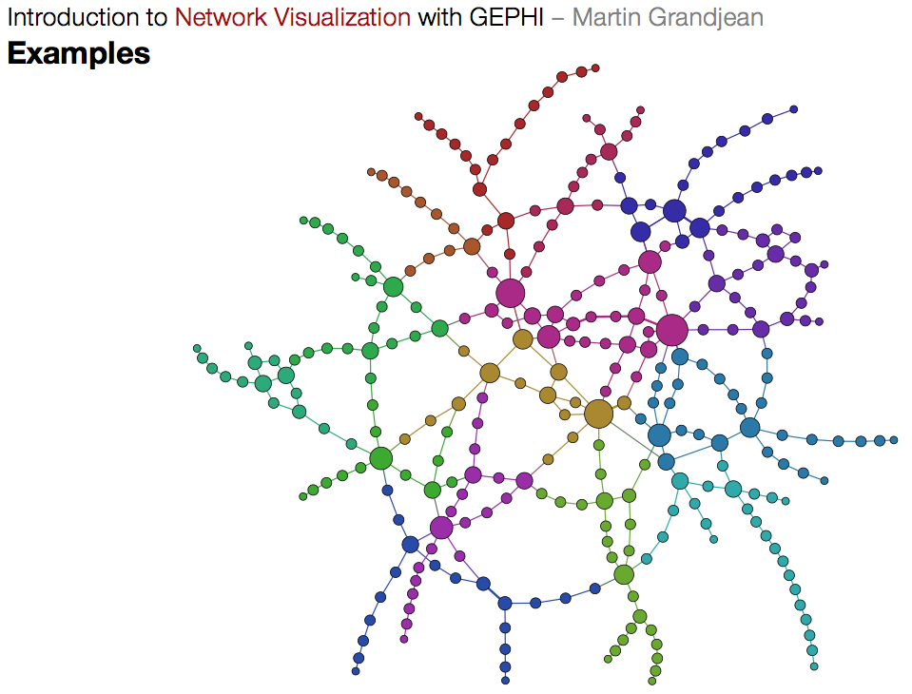
Beyond Trees
Trees are fantastic for representing ordered data or hierarchical data.
Real-world example: Paris Metro map.
This is not a tree as it contains cycles! More than one way to get from A to B.

Slide 13
Alternate Tree Definition
Tree. Consists of a set of nodes and a set of edges that connect those nodes.
Invariant. There is exactly one path between any two nodes.

Slide 14
Graph Definition
Graph. Consists of a set of nodes and a set of zero or more edges.
Each edge connects any two nodes. Not all nodes need to be connected.

Slide 15
Simple Graph Definition
Simple Graph. A graph with no self-loops and no parallel edges.
Unless otherwise stated, all graphs in this course are simple graphs.
Parallel
Self-loop

Slide 16
Types of Graphs
Directed
Undirected
b
b
e
Edge Labels
Acyclic
a
d
a
d
b
3
e
c
c
1
1
a
d
2
b
b
c
Cyclic
a
d
a
d
c
c

Slide 17
Beyond Trees
This Paris Metro map is a simple graph.
Undirected.
Connected.
Cyclic. Not a tree!
Vertex-labeled. Each node has a color.

Slide 18
Graph Connectivity Problem

Slide 19
s-t Connectivity
Let’s solve a classic graph problem called the s-t connectivity problem.
Given source vertex s and a target vertex t, does there exist a path between s and t?
Try to come up with an algorithm for connected(s, t).
3
0
1
4
6
s
2
5
7
t
8
Notes:
Q1: Try to come up with an algorithm for connected(s, t).

Slide 20
Applying Tree Traversal
Q
One possible recursive algorithm for connected(s, t).
Does s == t? If so, return true.
Otherwise, if connected(v, t) for any neighbor v of s, return true.
Return false.
What is problematic about this algorithm?
3
0
1
4
6
s
2
5
7
t
8
Notes:
Q1: What is wrong with this algorithm?

Slide 21
Applying Tree Traversal
A
One possible recursive algorithm for connected(s, t).
Does s == t? If so, return true.
Otherwise, if connected(v, t) for any neighbor v of s, return true.
Return false.
What is problematic about this algorithm?
Does 0 == 7? No, so…
if (connected(1, 7)) return true;
connected(1, 7):
Does 1 == 7? No, so…
if (connected(0, 7)) …
3
0
1
4
6
s
2
5
7
t
8

Slide 22
Depth-First Search
Demo
One possible recursive algorithm for connected(s, t).
Mark s as visited.
Does s == t? If so, return true.
Otherwise, if connected(v, t) for any unmarked neighbor v of s, return true.
Return false.
Each vertex visited at most once.
Depth-First Search.
3
0
1
4
6
s
2
5
7
t
8

Slide 23
Summary
Demo
Graphs are a more general idea than a tree. A tree is a graph where there are no cycles and every vertex is connected.
Trees have level-order traversals, and 3 depth-first traversals: pre-, in-, and post-order.
Depth-First Search is a powerful algorithm that can be used to solve many graph problems by performing actions or setting instance variables during a graph (or tree) traversal.
On graphs, we have DFS Preorder and DFS Postorder.

Slide 24
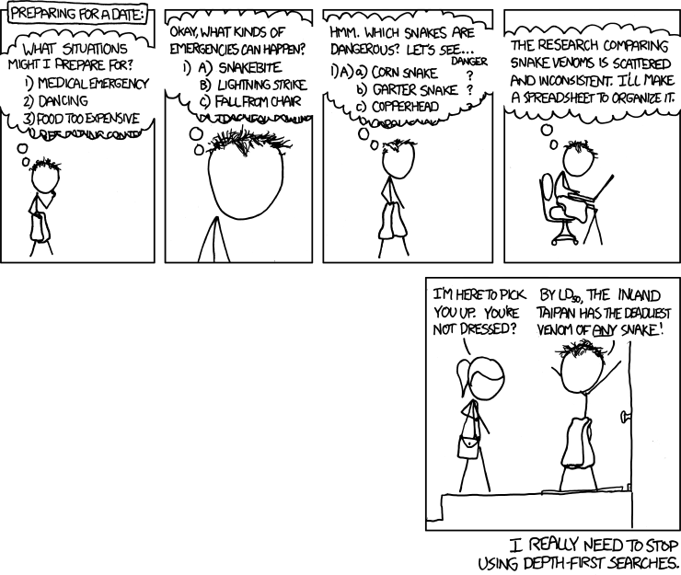
xkcd
DFS (Randall Munroe/xkcd)

